Slide 2
Chapter 12
Sustainable Tourism and Information Technology

Slide 3
Chapter 12 Learning Objectives
After studying this chapter you should be able to:
Analyze how IT can improve the environmental, social and economic sustainability of tourism organizations, communities and destinations
Explain how IT systems can be used to ensure environmental preservation, purity and physical integrity
Describe the role of IT systems in promoting social equity and community well-being, local empowerment and the preservation of cultural diversity
Understand how IT systems can ensure economic viability and local prosperity
Explain how IT systems can facilitate tourists to behave more sustainably in tourist settings

Slide 4
Key Concepts
Carbon calculator
Citizen and tourist scientists
Environmental management system (EMS)
Geographic information system (GIS)
Last-mile connectivity
Pro-poor tourism
Social capital and social equity
Social entrepreneurs
Voluntourist
Weather and climate change system

Slide 5
Sustainable Tourism
Sustainable Development
development that meets the needs of the present without compromising the ability of future generations to meet their own needs (WCED, 1987)
Sustainable Tourism
tourism that takes full account of its current and future economic, social and environmental impacts, addressing the needs of visitors, the industry, the environment and host communities (UNEP/UNWTO, 2005)

Slide 6
Applications of IT in Sustainable Tourism
Carbon Calculator
Community Informatics
Computer Simulations
Destination Management Systems (DMS)
Economic Impact Analysis
Environmental Management Systems (EMS)
Gamification
Geographic Information Systems (GIS)
Global Positioning Systems (GPS)
Intelligent Transportation Systems (ITS)
Location-Based Services (LBS)
Virtual Tourism
Weather and Climate Change Systems

Slide 7
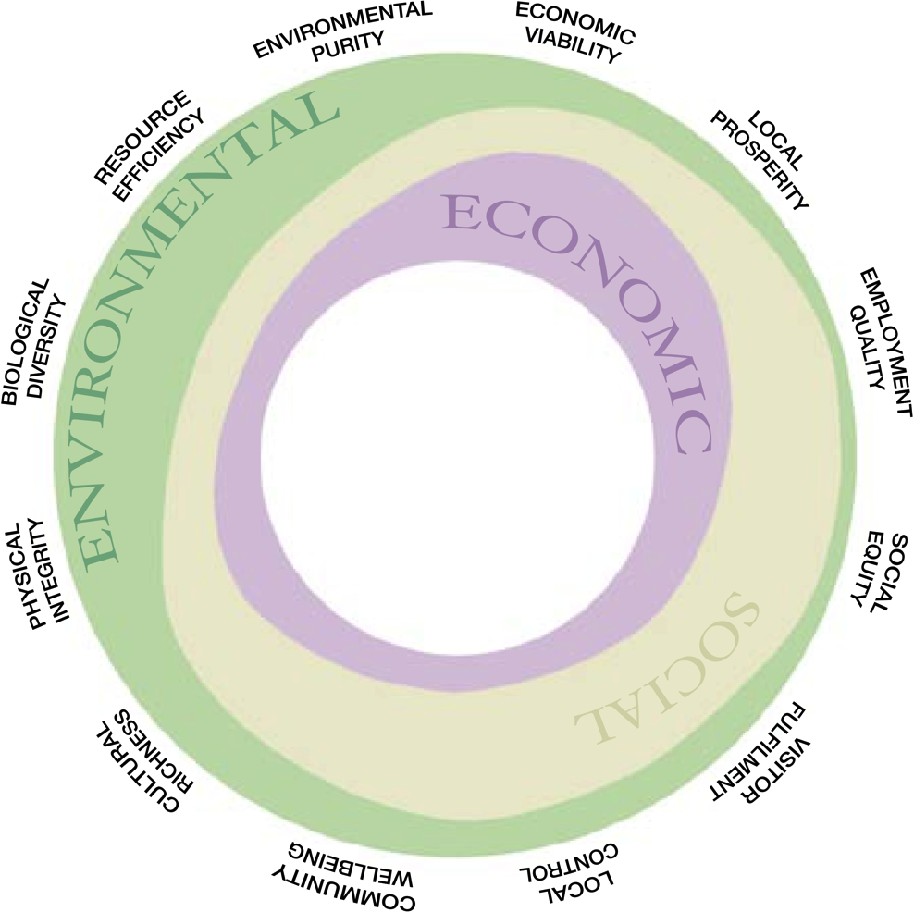
Figure 12.1 Twelve Aims of Sustainable Tourism Source: UNEP/UNWTO, 2005

Slide 8
Resource Efficiency and IT
Application of IT to reduce aviation fuel usage
Systems that optimize flight routes
Coordination of arrival and departure times to reduce holding patterns caused by delays
Continuous descent systems
Design of lighter and more fuel efficient aircraft
Energy and waste reduction in hotels
Energy management systems
Monitoring water usage

Slide 9
Environmental Purity & Physical Integrity
Use of DMSs to manage access to natural resources
Location-based services used for sustainable education and interpretation
Computer technology monitors and manages efficient use of resources including:
water (low-flush toilets, low-flow showerheads)
energy (solar power generators, energy-saving light-bulbs)
pollution (noise, air and visual pollution)
recycling and waste management
Carbon footprint calculators
Use of CAD software to design more efficient buildings

Slide 10
Mobile Apps for Environmental Awareness
Name | Designer | Purpose
Carbon Emissions Calculator | ICAO | Calculates CO₂ emissions from air travel
Environmental News Network | ENN | Provides global perspectives on environmental issues
Climate Pathways | New Venture Fund | Real-time interactive simulator to understand climate change
MyEarth | PiThree LLC | Teaches ways to save the environment and conserve resources
Earth Now | NASA | Data from satellites displayed in colored maps of sea level rises, water, temperatures etc.
offCents | offCents,Inc. | Provides real time tracking and calculation of carbon emissions from transportation

Slide 11
Biological Diversity
Citizen scientists: handheld devices can allow tourists to monitor animal and bird species and other environmental phenomenon on their digital devices as they travel
Tourist scientist: combining tourism, research, conservation and computers to identify and track flora and fauna (e.g. Earthwatch, Cyber trackers)
Voluntourists: make meaningful contributions to communities and wildlife in destinations

Slide 12
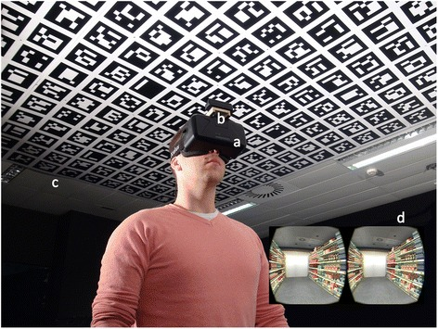
Virtual Substitute Travel Experiences
Tourists can experience some benefits of travel by staying home and using technology to virtually experience the destination, removing any environmental damage to the destination.
Examples:
360cities.net
Google Streetview
Google Earth VR
virtualtravelevents.com
Gala360

Slide 13
Social Equity & Community Wellbeing
Last-mile connectivity: IT advances have made it possible to connect even the most remote communities to address information asymmetry
IT democratizes and equalizes the community by giving all residents and enterprises equal access to technology
IT networks allow people to connect to knowledge, education, tourist markets, and destination management systems
IT contributes to social equity by attracting the right tourists
IT supports social enterprise
IT provides information and access for handicapped travellers
IT supports the monitoring and reporting of human rights abuses

Slide 14
Local Control
Community informatics empower communities and supports stakeholder engagement
Remote input to meetings
Electronic polling
Scenario-based design

Slide 15
Cultural Richness
IT can contribute to cultural richness by:
Disseminating better understanding of customs and traditions to the benefit of tourists and host communities
Promoting the visibility of cultural resources – especially new or small ones
Monitoring tourism impacts on cultural resources and visitor flow management strategies
Building partnerships between cultural and tourism operators to strengthen their market position

Slide 16
Economic Viability & Local Prosperity
IT can impact local prosperity by building:
Financial capital: providing online communication with lending organizations
Human capital: providing increased knowledge of new skills through distance learning and processes required for certification
Natural capital: providing opportunities to access national government policies online
Social capital: cultivating contacts beyond the local community
Physical capital: lobbying for the provision of basic infrastructure including data and telecommunications infrastructure

Slide 17
Economic Viability & Local Prosperity
IT Challenges
Lack of investment for IT
Lack of training and expertise
Lack of financial or technical infrastructure
Language barriers

Slide 18
Figure 12.4 Factors determining IT use by SMEs (Adapted from Buhalis, 2003, p. 143)
PUSH FACTORS
PULL FACTORS
Demands of Digital Travellers
Tourist Demand
Vendors of IT Systems
Interoperability with intranets, extranets & Internet
Small and
Medium
Tourism
Enterprises
Government Policies
Consortia & Marketing Alliances
Global Competition
Certification Programs
Education & Training
Accounting Systems

Slide 19
Employment Quality & Capacity Building
IT can be used to:
Attract talented employees to the tourism industry
Improve the quality of training and education
Examples
MOOCs
BEST Education Network
The International Ecotourism Society
Rainforest Alliance

Slide 20
Discussion Questions
What kind of digital infrastructure is needed for tourists to become citizen scientists in destinations?
What are the special needs and challenges faced by SME’s regarding the sustainable use of technologies in the digital age?
How can indigenous communities in tourism destinations be empowered with IT? Find examples of how technology has been used to improve the wellbeing of indigenous communities.

Slide 21
Discussion Questions
Identify a specific tourism destination or protected area that uses location-based services. How are these services likely to improve the destination’s sustainability?
Find a destination management system with features focusing on the environmental integrity of the destination. Describe these features and their likely impact.

Slide 22
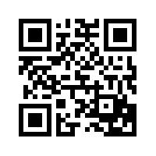
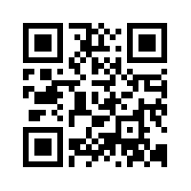
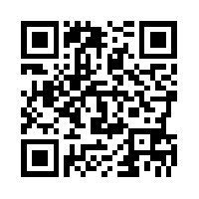
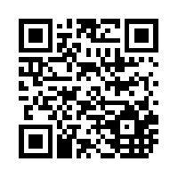
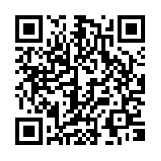
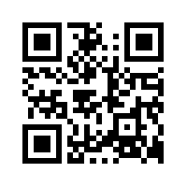
Useful Websites
 | UNESCO Sustainable Tourism www.unesco.org/education/tlsf/mods/theme_c/mod16.html |  | The International Ecotourism Society (TIES) www.ecotourism.org
 | Sustainable Tourism Online www.sustainabletourismonline.com |  | Rainforest Alliance www.rainforestalliance.org
 | National Geographic Center for Sustainable Destinations www.nationalgeographic.com/travel/sustainable.org/ |  | Conservation International www.conservation.org

Slide 23
Case Study ICONEM
Founded in 2013 and based in France
ICONEM creates:
digital replicas of endangered heritage sites
3D models
museum exhibits
Drone footage, 3D video, laser scanners, photogrammetry, and Lidar data is used to create highly accurate virtual replicas of real sites
Projects in 21 countries including Iraq, Afghanistan and Syria to capture sites under danger from war and neglect
Drones used to monitor looting and footage is cross-referenced with information from art markets and sellers to identify looters
Digital content curated for museum exhibitions immerses visitors in endangered sites

