Slide 2
Chapter 10
Technology-enabled Visitor Experiences

Slide 3
Chapter 10 Learning Objectives
After studying this chapter you should be able to:
Explain the role that IT plays in attracting visitors to attractions and events
Analyze the different roles of IT in the staging of memorable attraction and event experiences
Understand how IT can disrupt or moderate some visitor experiences
Apply various IT solutions to the management of visitors in attraction and event settings

Slide 4
Key Concepts
Android, animatronics, mechatronics
Augmented and virtual reality
Electronic ticketing system
Experience economy
Gamification
Interpretation and orientation
Virtual guide
Virtual queuing system

Slide 5
Understanding Attractions
 | Natural | Cultural
Permanent | flora and fauna terrestrial/marine parks & reserves landscapes geological features | theme parks art galleries & museums historic sites architectural wonders zoos & aquaria sports & entertainment sites shopping & tourist precincts
Temporary | volcanic eruptions astronomical events wildlife migrations coral spawning | sports events festivals concerts & performances conferences & meetings

Slide 6
Attracting Visitors
Visitor Information Centers
Mobile apps
Mediawalls
Twitter feeds
Information kiosks
Tablets
Sales and Distribution
Electronic ticketing

Slide 7
FIGURE 9.1 Technology-enabled experience hierarchy. (Neuhofer et al., 2014)
High
Technology-Empowered Experiences
Technology-Enhanced Experiences
Technology-Assisted Experiences
Conventional Experiences
LEVEL OF TECHNOLOGY
Interactive, immersive, pervasive technology
Interactive Web 2.0 technology
Non-interactive Web 1.0 technology
Low technology
Low

Slide 8
Staging Experiences
Role | Description
Enabler | Providing the inspiration, time and economic means for people to travel
Creator | Creation of tourism experiences and settings
Attractor | A focal point for travel experiences
Enhancer | Supporting comfort, orientation, interpretation and translation
Protector | Protect travelers and the resources that attract them
Educator | Reveal meanings and understandings of objects, artifacts, landscapes and sites
Substitute | Substitute experiences when resources are threatened, congested or not accessible
Facilitator | A tool for the tourism industry
Reminder | Recording, reflection and sharing of experiences
Destroyer | Negatively impacting the social, environmental and economic well-being of travelers or employees

Slide 9
Technology as an Enabler
Technology…
stimulates the broader socio-economic conditions for travel
increases productivity and relieves workers from mundane tasks
enables the movement of travelers
is used extensively in the production and delivery of goods and services
has provided easy access to travel information

Slide 10
Technology as a Creator
Engineers, architects and other professionals use CAD software to design tourism facilities
Technological infrastructures and machines create new opportunities for tourist experiences
Examples:
jet boating
jet skiing
Segway tours
simulators,
roller coasters
ski runs

Slide 11
Technology as an Attractor
Technology may be the focus of the experience that attracts visitors
Examples:
science and technology museums (e.g. EPCOT)
industrial sites (e.g. Guinness Brewery)
working farms (e.g. Dole Pineapple Plantation)
technology expos and motor shows
theme park rides
audio-visual effects
augmented and virtual reality

Slide 12
Technology as an Enhancer
Visitor orientation
Translation
Communication and translation
Planning and scheduling

Slide 13
Technology as a Protector
Protection of travelers
Electronic locking systems
Surveillance systems
Security scanning
Warnings sent to mobile devices
Water treatment and food safety
Protection of resources
Climate control systems
Documenting historical and natural artifacts
Monitoring and managing wildlife
Energy and waste management

Slide 14
Technology as an Educator
Interpretation and Edutainment
Virtual guides, audio guides & podcasts
Mobile technologies (QR codes, geofencing, wearable technologies)
Special effects
Virtual and augmented reality
Holographic projection
3D printing
Robotics and mechatronics
Interactive surfaces

Slide 15
Technology as a Substitute
Technology can re-enact or recreate environments, activities or events to provide substitute experiences for:
fragile or dangerous places
experiences that are too costly
attractions and objects that no longer exist
visitors with disabilities or mobility constraints

Slide 16
Technology as a Facilitator
Applications | Technology Examples
Marketing & Distribution | Websites, online bookings, apps, onsite purchases
Visitor management | Managing access, managing queues and crowding
Business intelligence | Tracking visitor patterns and behavior
Facility management | Property management systems, safety and security
Back office systems | Revenue management, accounting, payroll systems
Personnel | Employee access systems, laundry and costuming services
Automation | Cleaning, order taking, self-service kiosks, robotics

Slide 17
Technology as a Reminder
Visitors use IT to document, capture and share experiences
Examples
Image and video sharing
Geotagged images
Social media
Product reviews
Blogs

Slide 18
Technology as a Destroyer
Technology can also bite back, resulting in negative experiences, inconvenience or more serious consequences
Technology failure
Noise and visual pollution
Resource depletion

Slide 19
Managing Visitors
Admission | Smart cards, wristbands, barcoded tickets, biometrics, seat allocation
Orientation | LCD maps and directories, mobile apps
Ancillary Purchases | Cashless payment systems for parking, accommodation, food and beverages, photos and merchandize; geofencing and mobile notifications
Crowding & Queue Management | Visitor tracking, controlled access, forecasting demand, virtual queuing systems, wait time displays, queue entertainment
Business Intelligence & CRM | Strategic listening, monitoring visitor behavior
Safety & Security | CCTV, secure access, electronic lockers, safety systems
Casinos & Gaming | Slot machine maintenance and accounting, table games, player tracking and marketing, cage management, and staff systems

Slide 20
Discussion Questions
What technologies do you use when you are traveling? How can technology be used in the co-creation of visitor experiences?
Some commentators have predicted that virtual reality will eventually eliminate the need to travel. Do you think this is a valid prediction? Discuss your reasoning.
Think about places you have visited on your travels. Have you experienced any examples of technology in interpretive experiences? Were these technologies effective in supporting your learning or were they just a gimmick?

Slide 21
Discussion Questions
In this chapter we explored some of the challenges and opportunities of using IT for interpretation. What are some of the operational advantages and disadvantages of using technology in the creation of experiences?
Does the use of technology in attractions erode or enhance opportunities for high touch experiences? Discuss your reasoning and compare your points with other students.

Slide 22
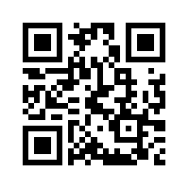
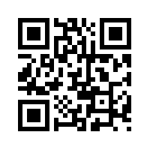
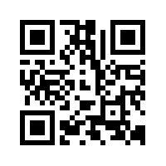
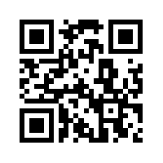
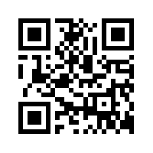
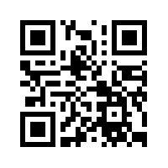
Useful Websites
 | IAAPA www.iaapa.org |  | International Council of Museums icom.museum
 | PDC Wristbands www.wristbands.com |  | Accesso accesso.com
 | iVenture Card www.iventurecard.com |  | Walt Disney Company thewaltdisneycompany.com

Slide 23
Case Study: Walt Disney Company
Any sufficiently advanced technology is indistinguishable from magic (Arthur C. Clarke)
Walt Disney Parks and Resorts include six destinations with 13 theme parks and 46 resorts in North America, Europe and Asia
Walt Disney was an early pioneer in the adoption of new technologies for animation, live action films, nature documentaries, special exhibits, theme park rides and city planning
MyMagic+
My Disney Experience web site and mobile app
MagicBand RFID wristband
Provides theme park entry, hotel room access, purchases, dinner reservations, fastpass and photopass access, and various interactive experiences

